Slide 1
Lending Club Case Study EDA - Presentation
Contributors:
Uday kumar adavi
bibhu sundar sahoo

Slide 2
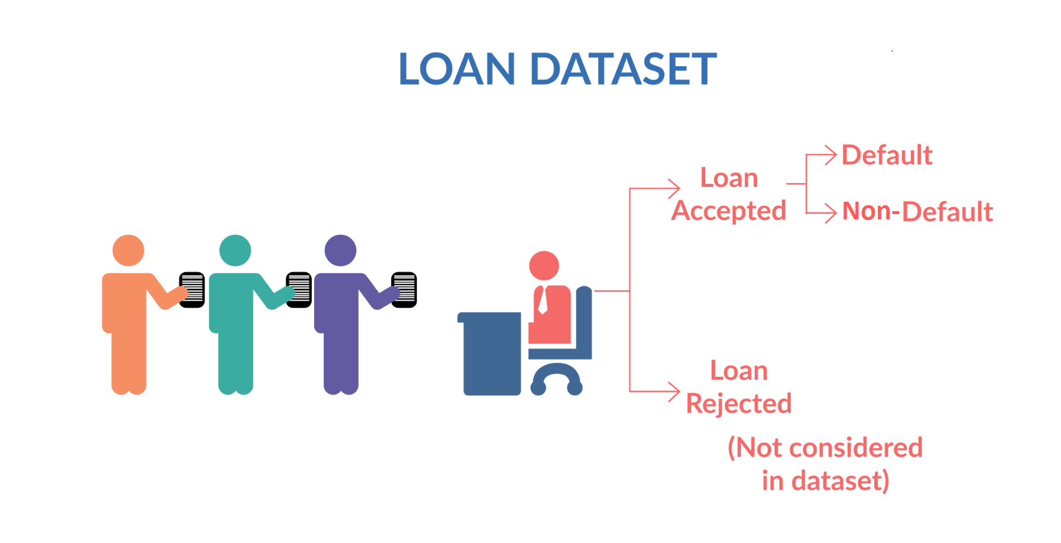
Lending Club business
Background of the lending club business and the problem of default

Slide 3
Approach to EDA

Slide 4
Example of categorical variable and how we analysed it, came up with findings, insights & recommendation
All related charts form python notebook
Write some text box comments

Slide 5
Example of numerical variable and how we analysed it, came up with findings, insights & recommendation
All related charts form python notebook
Write some text box comments

Slide 6
Final summary slide – can be the same as the summary table in the python note book

